Slide 1
The Revenue Consequences of Tax Avoidance and Evasion
June 7, 2019
Richard Prisinzano

Slide 2
Introduction

Slide 3
Types of Revenue Estimates
“Wicked Static”
  Base of Tax remains unchanged
  Conventional (formerly Static)
    Includes Behavioral Responses
    Dynamic (not discussed today)
      Includes Macroeconomic feedbacks

Slide 4
Gasoline Tax Example

Slide 5
Flexibility of Income
Intertemporal Shift
  Capital Gains
Base Shift
  Choice of Entity
Flavor Shift
  Capital vs. Labor
Combination

Slide 6
Order
Eric Zwick
Richard Prisinzano
Michael Knoll
David Kamin
Moderated Discussion
Open Q & A

Slide 7
Potential Conversions

Slide 8
Pass-Through vs. C-Corporation
A Firm’s choice of business structure is likely a function of both tax and non-tax concerns.
C-corporations: double taxation, limited liability, broad access to capital markets, deferral.
Sole Proprietors: single layer of tax but includes Self Employment Contributions Act (SECA) rates
S-Corporations: single layer of tax, limited liability, some income avoids SECA, subject to closely held rules
Partnerships: single layer of tax (individual partners), limited liability, some income avoids SECA, flexibility in distribution/form.

Slide 9
Ease of Conversion
Check-the-Box rules allow Pass-Throughs to choose taxation under the corporate system.
Corporate Taxation is simpler than Partnership
Conversion to C-corporation is largely costless
Conversion to Pass-Through is *not* costless

Slide 10
Tax Rates of Types of Businesses
  Tax wedge between the corporate and individual tax base is:
  W = Τ_{net corp} - Τ_{ind}
  Where:
  Τ_{net corp} = Τ_{corp} + (1 – Τ_{corp} ) · ( α · Τ_{div} + ( 1- α ) · β · Τ_{cg} )
α = share of corporate income paid out as dividends
β = a measure of the benefits of capital gains deferral

Slide 11
Table 1: Top Statutory Tax Rates in 2017 and 2018
 | 0% Retained
 | 2017 |  | 2018
Type of Tax | C-corporation | Pass-through | C-corporation | Pass-through | with 20% Deduction
Entity Tax | 35.0% | 0.0% | 21.0% | 0.0% | 0.0%
Individual Tax | 20.0% | 39.6% | 20.0% | 37.0% | 29.6%
Net Investment Income Tax | 3.8% | 3.8% | 3.8% | 3.8% | 3.8%
Net Rate | 50.5% | 43.4% | 39.8% | 40.8% | 33.4%
Rate Differential |  | 7.1 |  | -1.0 | 6.4
 | 100% Retained
 | 2017 |  | 2018
Entity Tax | 35.0% | 0.0% | 21.0% | 0.0% | 0.0%
Individual Tax | 0.0% | 39.6% | 0.0% | 37.0% | 29.6%
Net Investment Income Tax | 0.0% | 3.8% | 0.0% | 3.8% | 3.8%
Net Rate | 35.0% | 43.4% | 21.0% | 40.8% | 33.4%
Rate Differential |  | -8.4 |  | -19.8 | -12.4

Slide 12
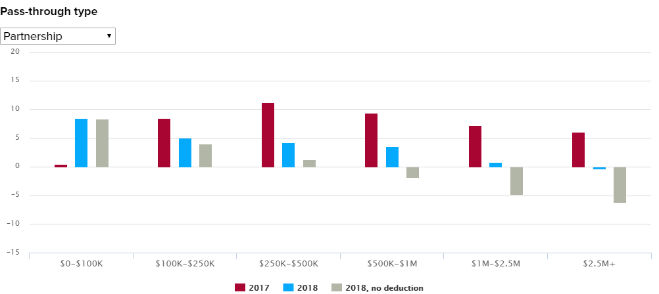
Tax Rate Differential – 52% Retained

Slide 13
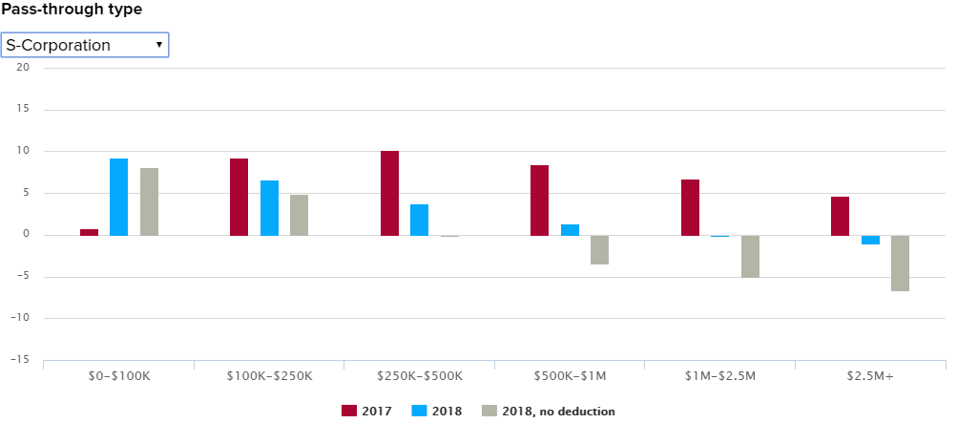
Tax Rate Differential – 52% Retained

Slide 14
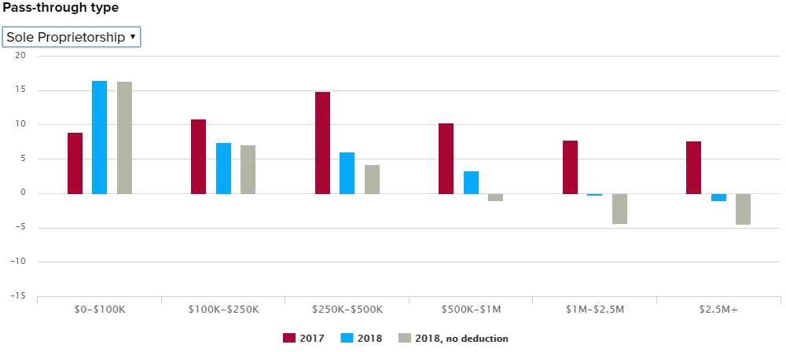
Tax Rate Differential – 52% Retained

Slide 15
Observations
Not everyone optimizes their Tax Position
235,780 of 24.4M “Business Owners”
77% of beneficiaries > $500K in AGI
17.5% of Pass-Through Ordinary Business Income

